Slide 1
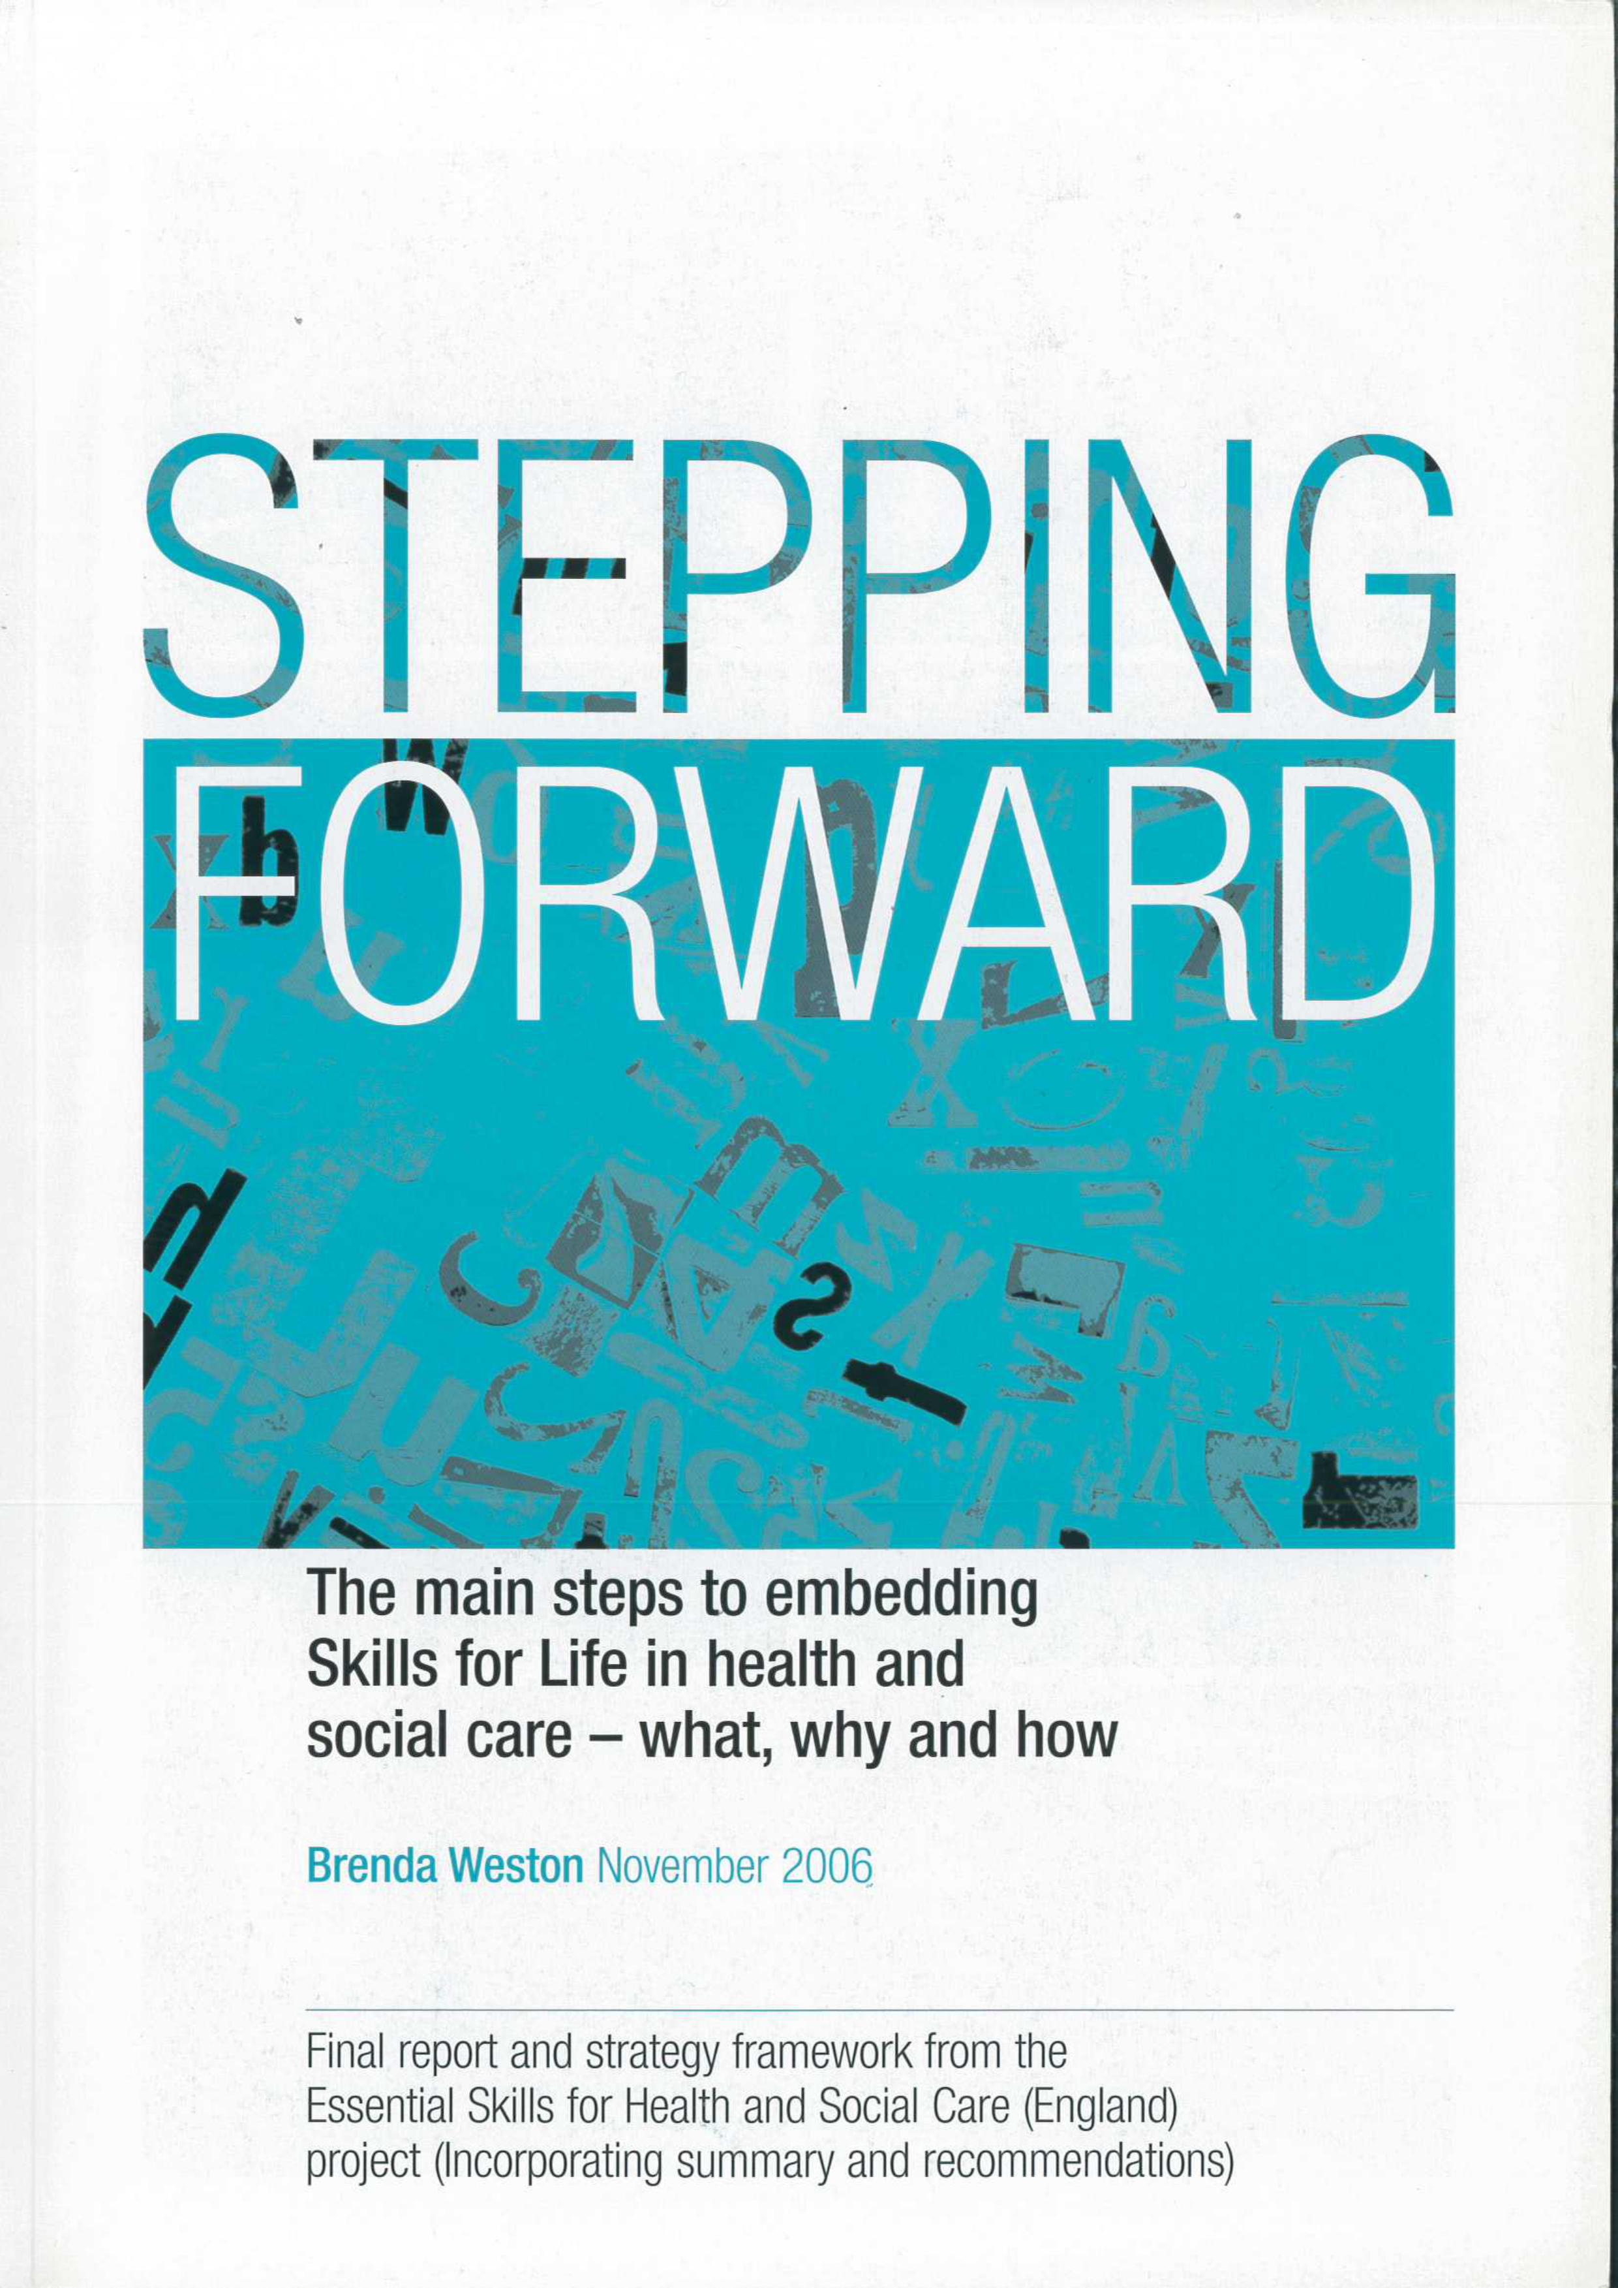
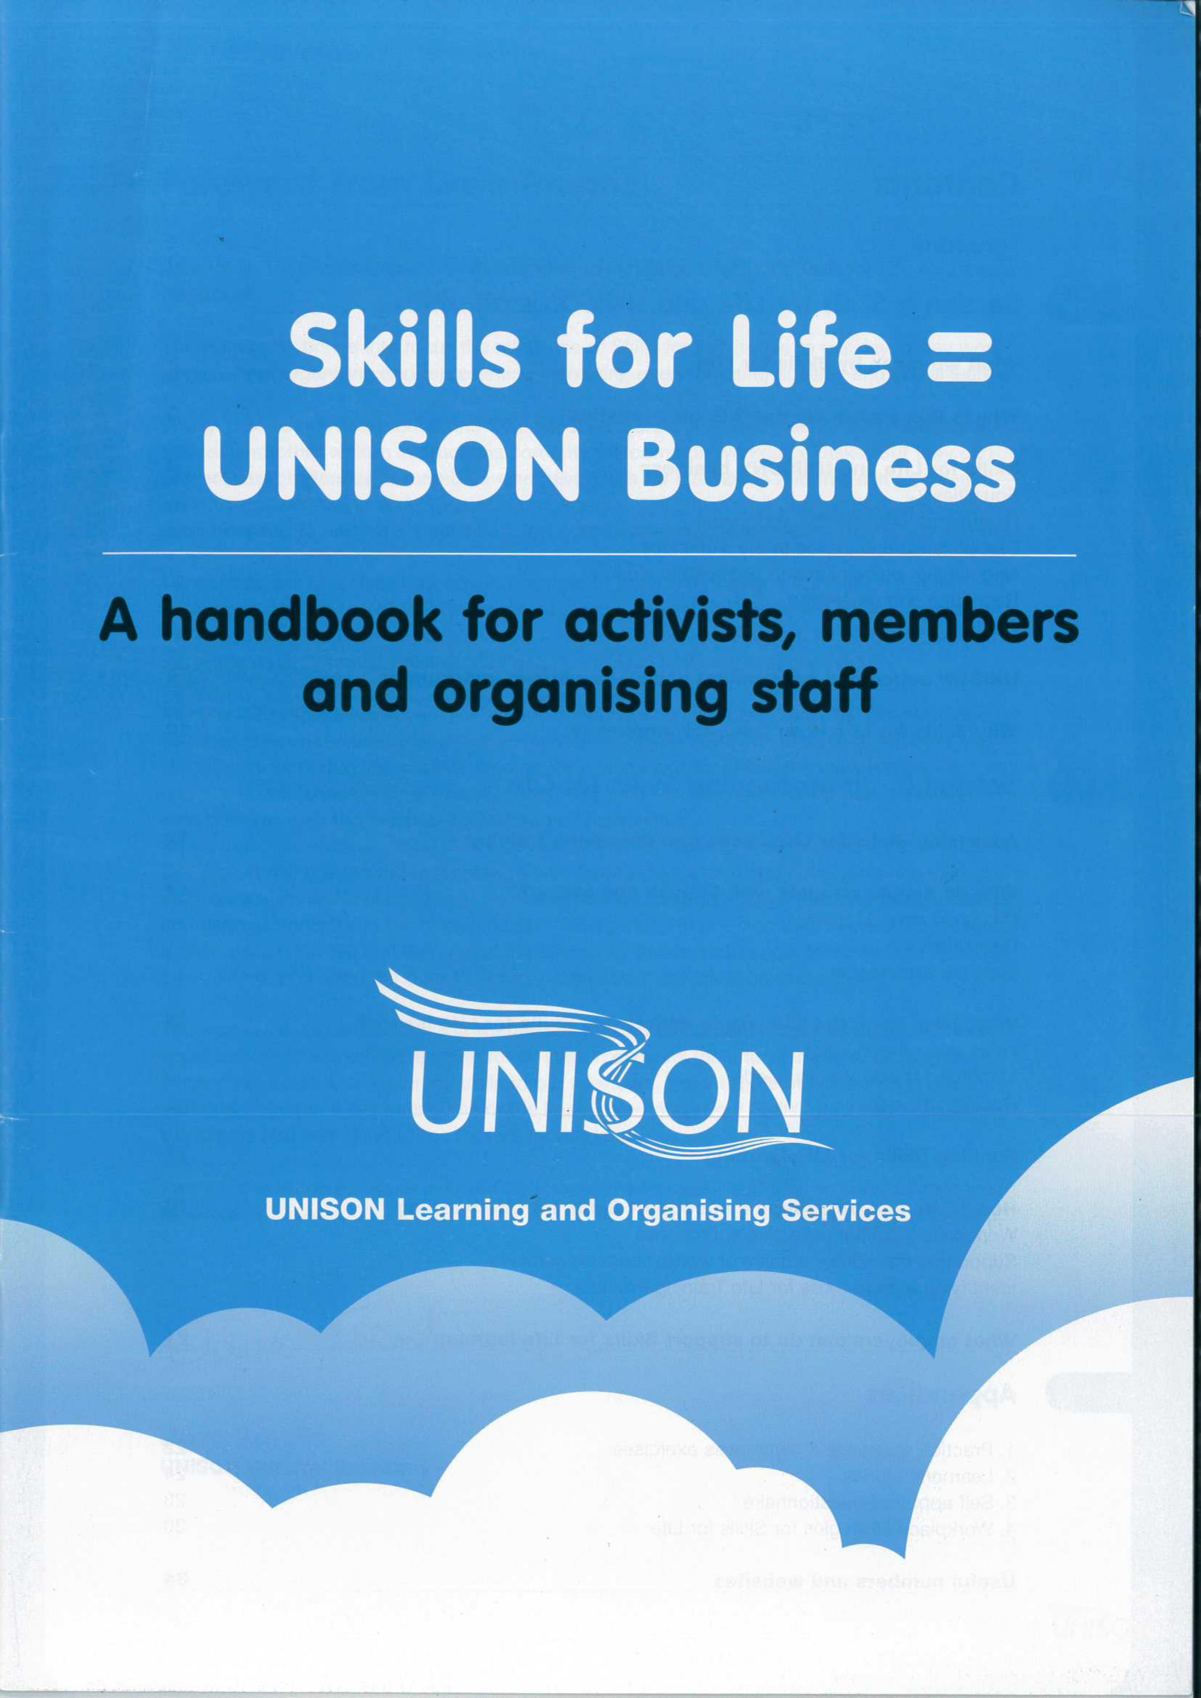
UNISON and Functional Skills
Gavin McCann
East Midlands Regional Learning & Development Organiser

Slide 2
Skills for the Future - 2019
Skills or confidence in literacy or numeracy ever stopped you from doing any of the following?

Slide 4
Functional Skills in Local Government
Get On Local Government – Local Government Skills for Life Strategy 2005 -2007
Estimated that
230,000 LG employees (11%) are below level 1 in literacy
780,000 LG employees (40%) are below level 1 in numeracy

Slide 5
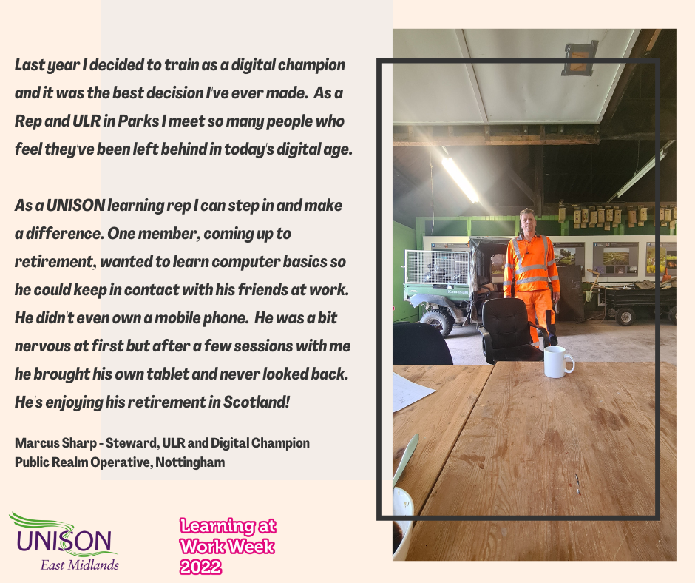
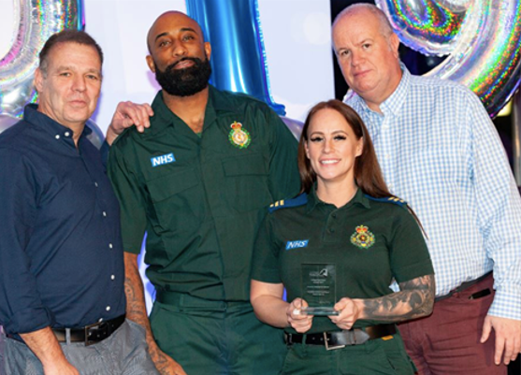
UNISON and Functional Skills – Our role
Bring Functional Skills into the Workplace
Introduce funding and providers to the employer
Negotiate with employer – Time-off
Liaise with providers
Facilitate training and identify funding
Conduct Skills Checks
Gain interest of colleagues – Union seen as trustworthy
and ‘one of us’
Work with line managers
Provide 1-2-1 support
Address issues in the workplace preventing access
e.g. time, confidence etc
Functional Skills Training at London Ambulance Service organised by their ULR

Slide 6
2. Get On At Work
Originally funded by the Learning & Skills Councils
Almost 1000 maths and English skills checks in last 4 years
Since Covid – All skills checks & full qualification delivered online
2022/23 partnership with Futures
Mainly focused on members who have some confidence in their skills
Process:
UNISON members in an area/county contacted
UNISON Branches and ULRs spread the word
C. Any member wishing to participate contacts Chris Donkin
D. Futures send the link to the skills checks ahead of the 2-day window
E. Results are given to the member and advice offered
F. The member is asked whether they wish to enrol
G. Futures contact the member to offer advice and guidance and support them on their journey

Slide 7
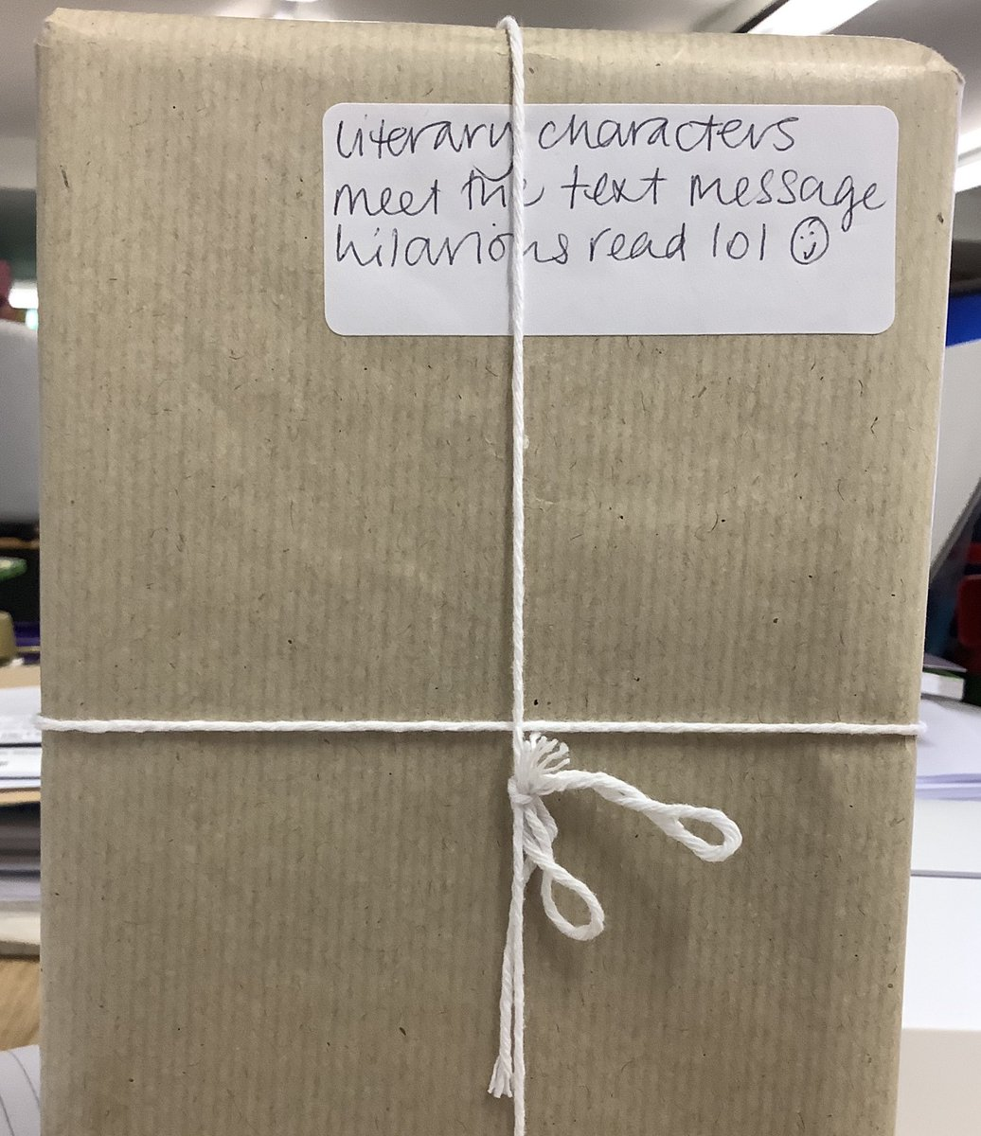
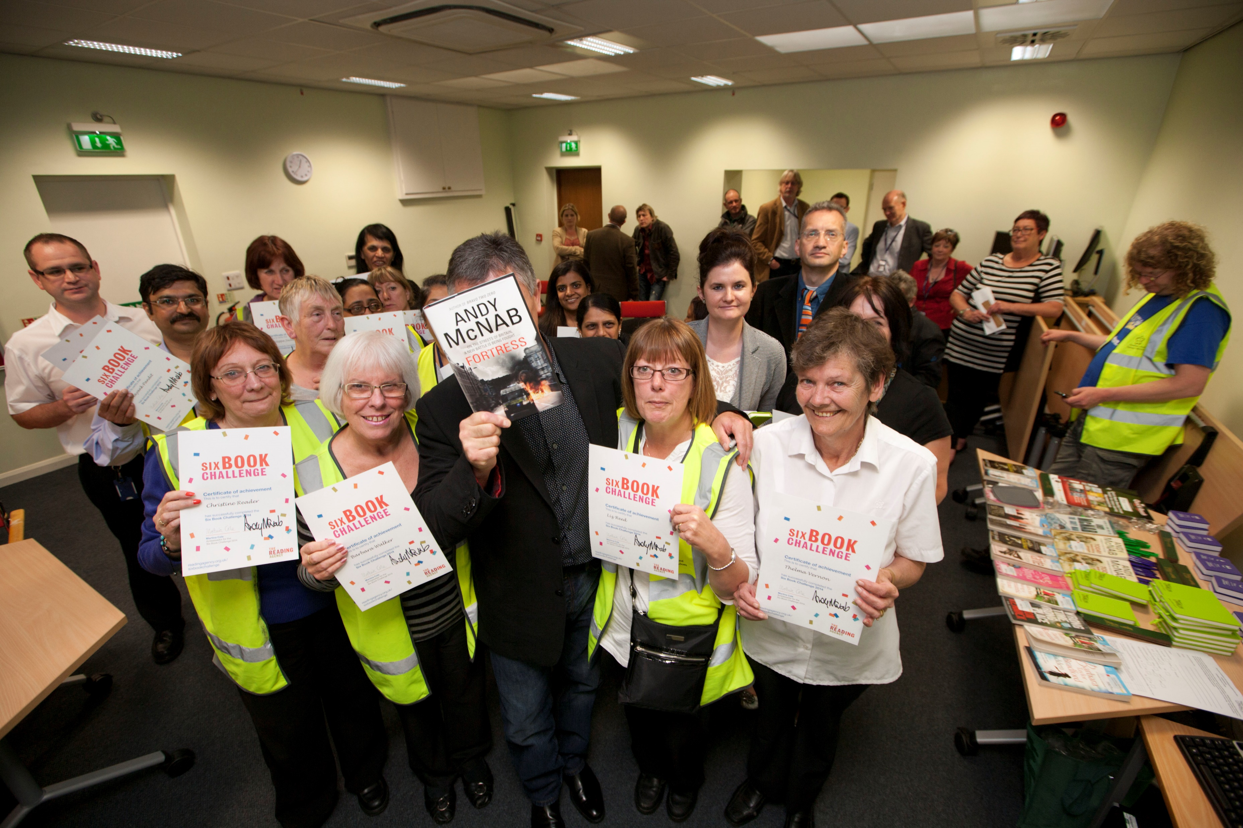
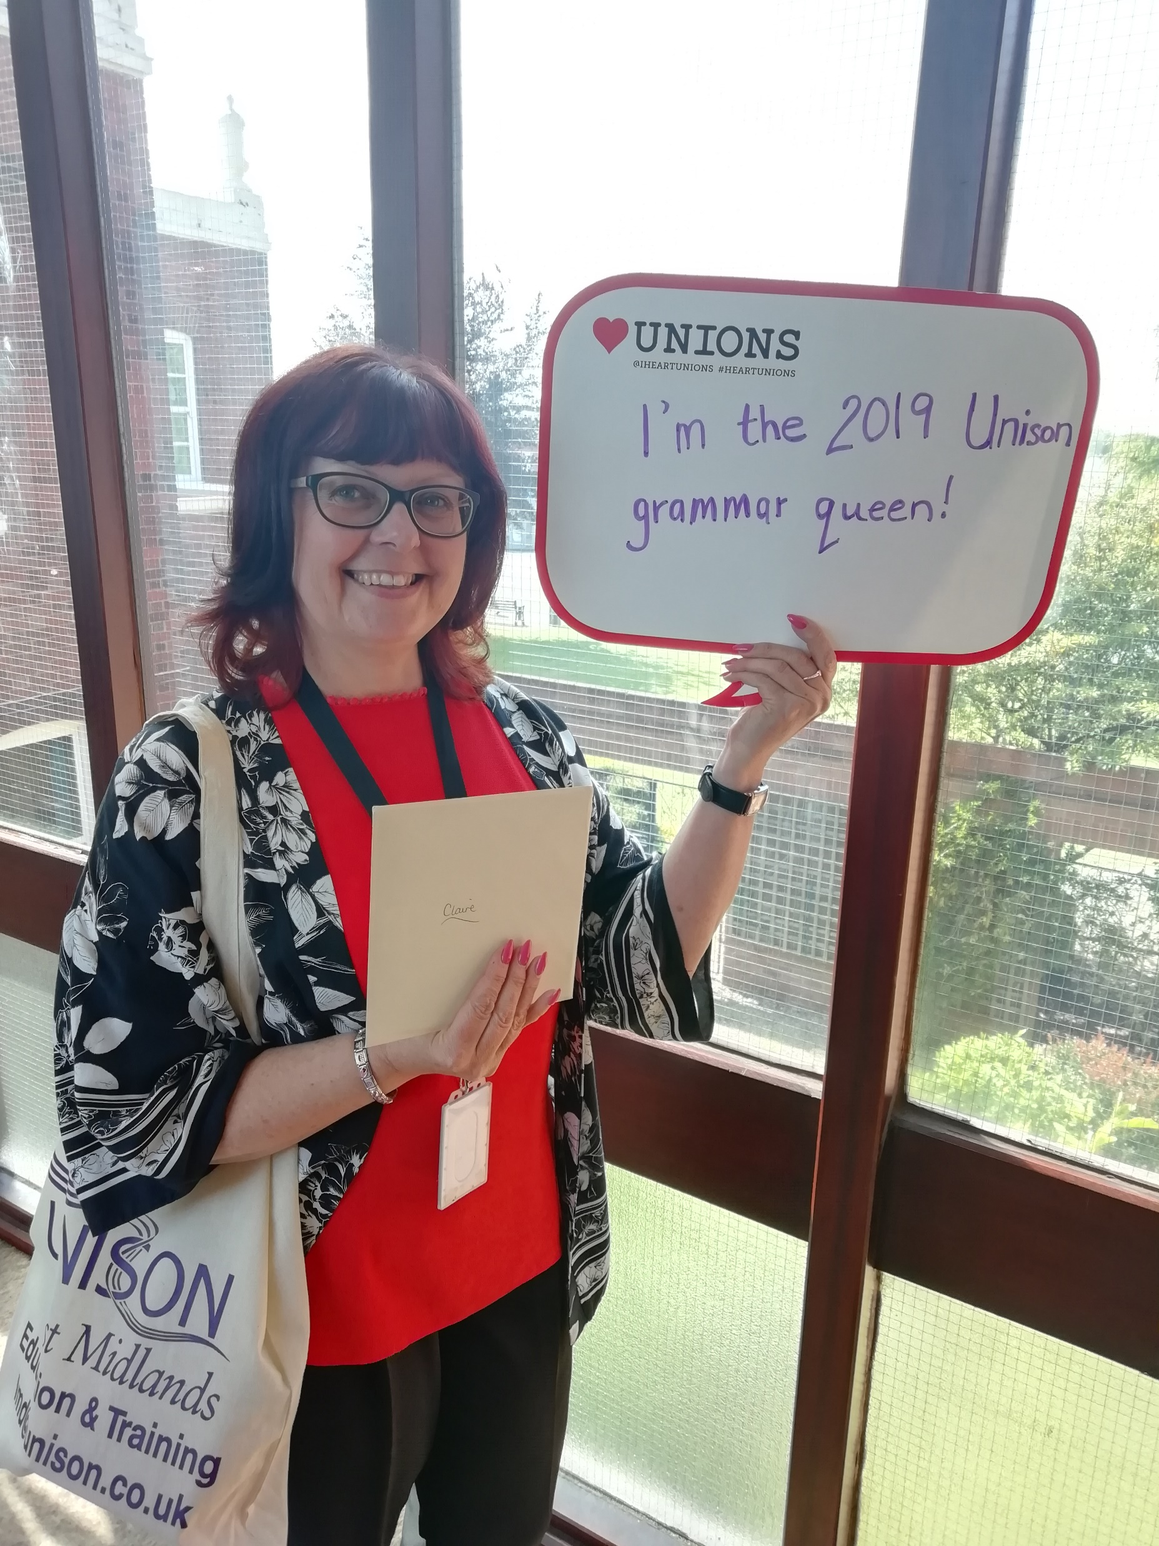
2. Provide Informal Literacy & Numeracy
Support for Reading Challenges/Quick Reads/Book Swaps/workshops
Workshops
Working with Providers
ULR 1-2-1 support
Blind date with a Book – Lincoln university
World Book Night – Lincs Police
Reading Ahead Challenge/Author visits – Leicester City
Lunchtime Grammar workshops – NW Leics
Numeracy workshops
Literacy Toolkit

Slide 8
Multiply Funding
Multiply is Government funding to support numeracy
Training is not linked to a qualification
All training is free
Courses can be organised on most topics with numeracy embedded. E.g. Helping kids with maths homework, Cooking on a Budget
Courses can be set up to address numeracy needs of a group e.g. ratios and area for staff who used chemicals or area for housing staff
Example of offer in Nottinghamshire - https://www.inspireculture.org.uk/skills-learning/multiply/
For details and contacts email Gavin McCann (g.mccann@unison.co.uk)

